Slide 1


Go-Session-4
---------------------
Goroutine
By Shadab Akhtar

Slide 2
--------------------------------------------------------------------------------------------------
Module Introduction
--------------------------------------------------------------------------------------------------
In this module, we will cover
What is a Goroutine?
Understanding Goroutine Architecture
How to call a Goroutine function?

Slide 3
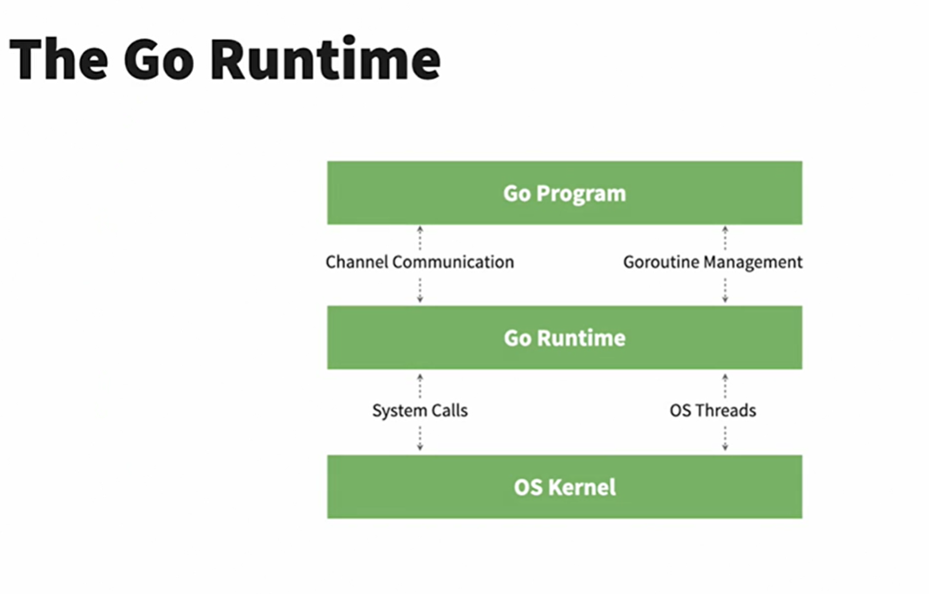
------------------------------------------------------------------------------------------------
What is a Goroutine?
------------------------------------------------------------------------------------------------
A Goroutine in Go (often abbreviated as "goroutine") is a lightweight, concurrent thread of execution. It's a fundamental concept in Go's concurrency model and plays a crucial role in building efficient and concurrent programs.

Slide 4
### Layers:
1. **Go Program**:
- This represents the Go code written by the developer.
- **Channel Communication**: Channels in Go provide a way for goroutines to communicate with each other and synchronize their execution.
- **Goroutine Management**: Go programs make extensive use of goroutines, which are lightweight threads managed by the Go runtime.
2. **Go Runtime**:
- This is the layer that manages the execution of the Go program.
- **System Calls**: The Go runtime makes system calls to interact with the underlying operating system. These can include operations like I/O, networking, and more.
- **OS Threads**: The Go runtime manages a pool of OS threads. It maps many goroutines to these OS threads, allowing for efficient use of system resources.
3. **OS Kernel**:
- The operating system kernel provides the fundamental resources and services needed by the Go runtime.
- It manages low-level tasks such as memory management, process scheduling, and hardware communication.

Slide 5
### Flow of Execution:
- The **Go Program** is executed by the developer's code which uses goroutines and channels for concurrent operations.
- The **Go Runtime** oversees the execution of these goroutines, maps them to OS threads, and makes necessary system calls to the OS kernel.
- The **OS Kernel** then provides the required low-level support to the Go runtime, such as executing threads and handling system calls.
### Key Concepts:
- **Channel Communication**: Facilitates communication and synchronization between goroutines.
- **Goroutine Management**: Efficiently manages the lifecycle and execution of goroutines.
- **System Calls**: Allows the Go runtime to request services from the OS kernel.
- **OS Threads**: The Go runtime uses a pool of OS threads to execute goroutines.
This layered architecture allows Go to efficiently manage concurrency and parallelism, providing robust performance for concurrent applications.

Slide 6
Here's how you can achieve concurrent execution of tasks in Go:
Define the Tasks: Identify the tasks you want to execute concurrently. These tasks can be functions or methods that perform the work you need.
Create Goroutines: Start a Goroutine for each task by using the go keyword followed by the function call. This initiates the concurrent execution of the tasks.
Synchronize and Communicate: If your tasks need to share data or communicate with each other, use channels to facilitate communication. Channels ensure safe data sharing and synchronization between Goroutines.
Wait for Completion (Optional): If your main program needs to wait for all Goroutines to finish before proceeding, you can use synchronization mechanisms like WaitGroups.

Slide 7
Key characteristics of Goroutines in Go include:
Concurrency: Goroutines enable concurrent execution in Go. They are designed to be lightweight and allow you to efficiently run thousands or even millions of them concurrently within a single Go program.
Multiplexing: Goroutines are multiplexed onto a smaller number of operating system threads (usually just a few) by the Go runtime. This means that the Go runtime manages the scheduling of Goroutines, and you don't need to explicitly manage threads yourself.
Low Overhead: Creating and managing Goroutines is relatively inexpensive in terms of memory and CPU overhead compared to traditional threads provided by the operating system.
Communication: Goroutines communicate and synchronize using channels, which are a built-in mechanism in Go. Channels allow safe data sharing and communication between Goroutines without the need for explicit locking and mutexes.

Slide 8
------------------------------------------------------------------------------------------------
How to call a Goroutine function?
------------------------------------------------------------------------------------------------
To call a Goroutine function in Go, you simply use the go keyword followed by the function call.
Here's the basic syntax:
go functionName(arguments)
Here's a step-by-step guide on how to call a Goroutine function:
Define a function that you want to execute concurrently as a Goroutine.
Use the go keyword followed by the function call to start the Goroutine.
The Go runtime will handle the scheduling and execution of the Goroutine in the background.

Slide 9
--------------------------------------------------------------------------------------------------
Module Summary
--------------------------------------------------------------------------------------------------
In this module, we have covered
-------------------------------
What is a Goroutine?
Understanding Goroutine Architecture
How to call a Goroutine function?

Slide 10


Slide 11


